Slide 1


Department of Computer Science and Engineering
AI-Driven Multi-Level Animal Detection and Deterrence System for Protecting Agricultural Lands
Aparna V/ 211421104023
Bindu Sudeeksha M/ 211421104041
Kamini P/ 211421104118
Guide:
S.T. SANTHANALAKSHMI, M.Tech(Ph.D) ,Asst Professor(GRADE I)
Coordinator:
Dr. Kavitha Subramani M.E.,Ph.D.,(Professor)

Slide 2
Abstract
The intrusion of wildlife into agricultural lands causes significant crop destruction and economic loss for farmers.
A multi-level animal detection and deterrence system is proposed to mitigate this issue.
The system employs a three-phase approach: early warning, species identification, and automated deterrence.
This system protects crops, minimizes harm to wildlife, and supports ecological balance.
The system uses ultrasonic sensors to detect animals and triggers a buzzer alert.
An AI model identifies the species, targeting only harmful animals.

Slide 3
Introduction
Agricultural lands near forested areas are vulnerable to wildlife intrusions.
These intrusions lead to crop damage and financial strain for farmers.
Existing systems for animal identification are often inefficient and lack scalability.
These systems struggle with large datasets, low accuracy in complex scenarios, and ineffective clustering of similar-looking animals.
The proposed system offers a more efficient, cost-effective, and humane solution.

Slide 4
Objective of the Project
To use ultrasonic sensors for initial animal detection.
To employ an AI model to accurately identify animal species.
To activate an automated deterrence mechanism (shock circuit) for harmful animals.
To provide an automated and cost-effective solution for farmers.
To develop a multi-level animal detection and deterrence system.

Slide 5
Literature Survey
S.NO | YEAR | AUTHOR DETAILS & TITLE | JOURNAL DETAILS | METHODOLOGY | OUTCOME
1 | 2022 | M. Ali, F. M. M. Iqbal, "Detection of Wildlife Animals using Deep Learning Approaches: A Systematic Review" | IEEE Explore | Review of deep learning techniques (CNNs, RNNs) | Analysis of challenges (varied appearances, datasets) and potential of deep learning for wildlife detection
2 | 2023 | D. V. Smith, J. H. Davis, "Automated Recognition of Wild Animal Species in Camera Trap Images Using Deep Learning Models" | IEEE Explore | Application of convolutional networks | Improved accuracy in recognizing and categorizing wild animals in camera trap images; addresses image noise and occlusion
3 | 2023 | D. V. Smith, J. H. Davis,Automated Recognition of Wild Animal Species in Camera Trap Images Using Deep Learning Models | IEEE Explore | CNNs and optimization techniques | Directly relevant to our project's use of deep learning for species identification, particularly in handling noisy sensor data.

Slide 6
Literature Survey
S.NO | YEAR | AUTHOR DETAILS & TITLE | JOURNAL DETAILS | METHODOLOGY | OUTCOME
4 | 2024 | Nitika Goyal, Navneet Kaur Sandhu, Animal Intrusion Detection and Alert System for Crop Protection | International Journal of Intelligent Systems and Applications in Engineering | Utilized YOLOv5 network for real-time detection and tracking of live animals; integrated IoT for real-time alerts to farmers. | Achieved detection accuracy between 85% to 95% across various animal categories.
5 | 2023 | Sudhakar, Sreerambabu, Rajkumar, Santhosh, Camera Vision Based Animal Repellent System for Agriculture using Machine Learning | International Journal for Research in Applied Science and Engineering Technology | Combined Computer Vision with Deep Convolutional Neural Networks (DCNN) | Effectively identified and repelled wild animals, reducing crop damage; provided real-time alerts to farmers.
6 | 2023 | Nandhini G S, Kaviyarasu M, Saminathan K, Aakash A, Crop Protection and Monitoring from Animal Attacks Using IOT Solutions | International Journal of Engineering Research & Technology | CNN-based machine learning model | Effectively identified target animals such as deer, wild boar, and nilgai; deterred animals from entering farms, minimizing crop damage.

Slide 7
Problem Statement
The core problem is the increasing conflict between wildlife and agricultural activities, specifically the intrusion of wild animals into agricultural lands near forest areas. This intrusion leads to significant crop damage and economic losses for farmers, posing a threat to both agricultural productivity and wildlife conservation.

Slide 8
Proposed System
It operates in three levels:
Level 1: Initial buzzer alert to warn of animal presence.
Level 2: AI-based identification of the animal species.
Level 3: Activation of a shock circuit to deter harmful animals.
The system uses ultrasonic sensors to detect approaching animals.
The system is designed to protect crops, minimize harm to wildlife, and enhance agricultural safety.

Slide 9
Module 1 - Object Detection
Ultrasonic sensors are used to detect approaching animals.
The sensors trigger a buzzer alert to notify the farmer.
Arduino Uno processes the sensor data and manages the alert.
This module provides real-time monitoring and early warning of animal intrusion.
Key components: Ultrasonic Sensor, Arduino Uno, Buzzer, LCD.

Slide 10
Module 2 - Animal Identification
An AI model using the YOLO algorithm identifies the species of detected animals.
If a harmful animal is identified, the system triggers a distraction mechanism.
Ultrasonic sound is produced from a speaker to deter the animal.
This module ensures targeted and effective deterrence.
Key components: Arduino Uno, YOLO Algorithm, DF Player Speaker.

Slide 11
Module 3 - Shock Mechanism
Ultrasonic sensors monitor the range of approaching animals.
When an animal is within a predefined distance, the sensor signals a relay.
The relay activates a shock circuit to deter the animal.
This automated response protects crops without manual intervention.
Key components: Ultrasonic Sensor, Arduino Uno, Relay, Nervo Simulator.

Slide 12
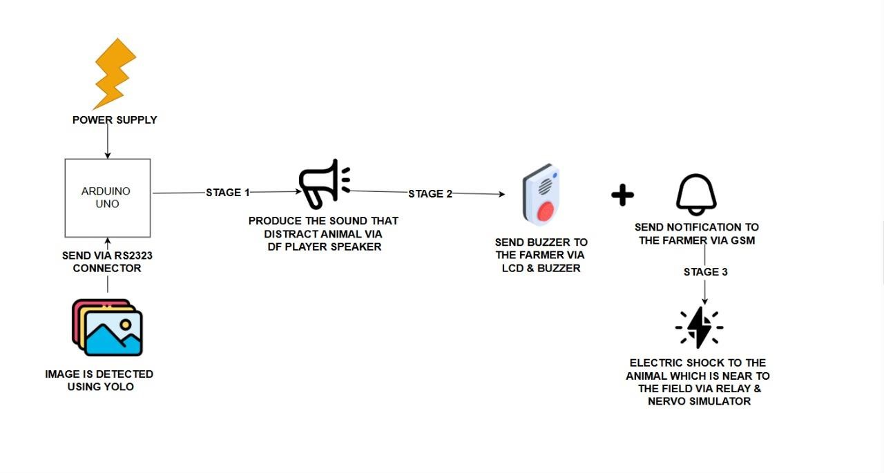
Architecture Diagram

Slide 13
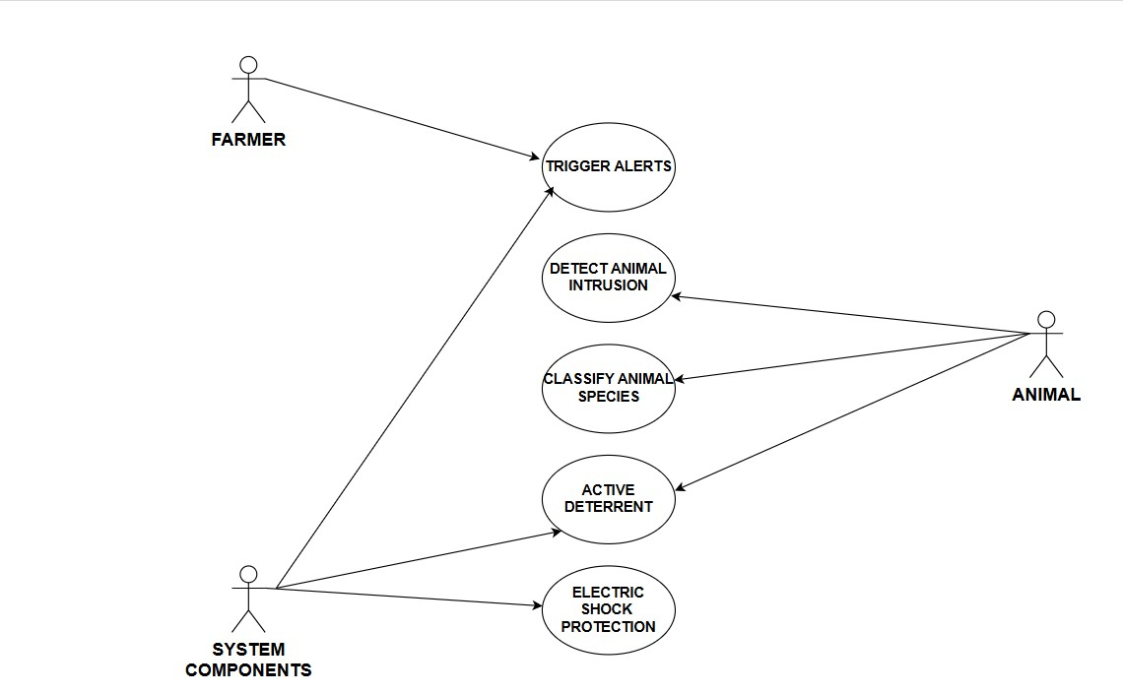
UseCase

Slide 14
Software / Hardware used
Hardware:
Ultrasonic Sensors: Detect animal presence.
LCD: Displays alerts and information.
Buzzer: Provides an audible alert.
DF Player Speaker: Produces ultrasonic sound to deter animals.
Relay: Activates the shock circuit.
Nervo Simulator: Delivers a mild electric pulse.
Software:
Embedded C: Programming language for microcontroller.
Arduino IDE: Software for writing, compiling, and uploading code.
YOLO Algorithm: AI model for animal species identification.
Arduino Uno: Microcontroller for processing sensor data and managing alerts.

Slide 15
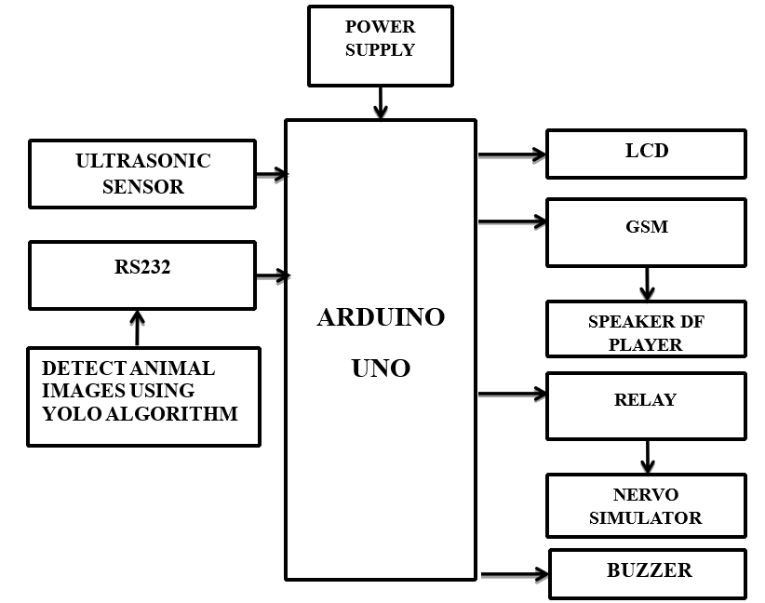
Block Diagram

Slide 16
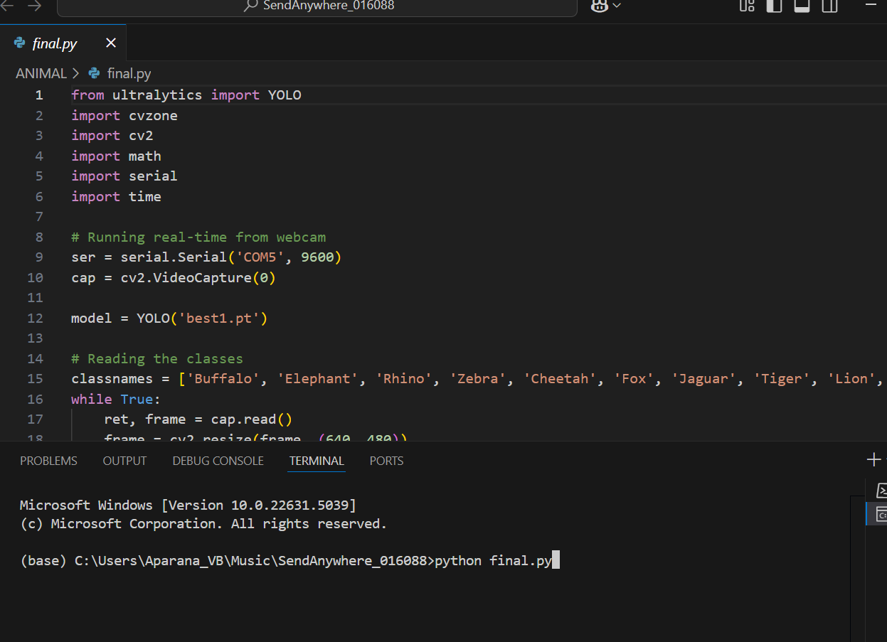
Screen Shots

Slide 17

Screen Shots

Slide 18
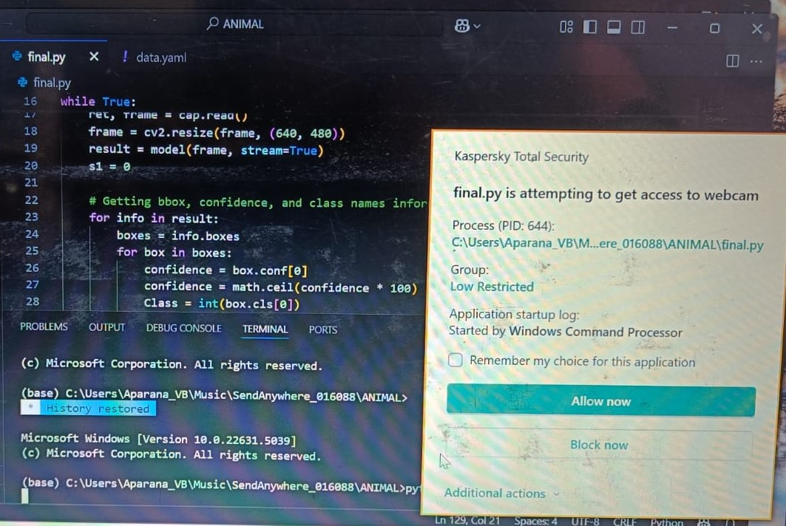

Slide 19
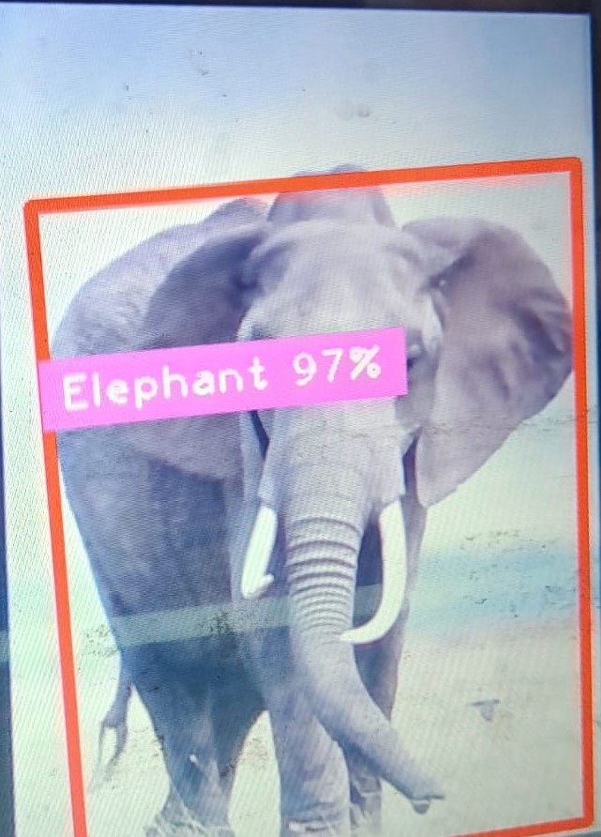
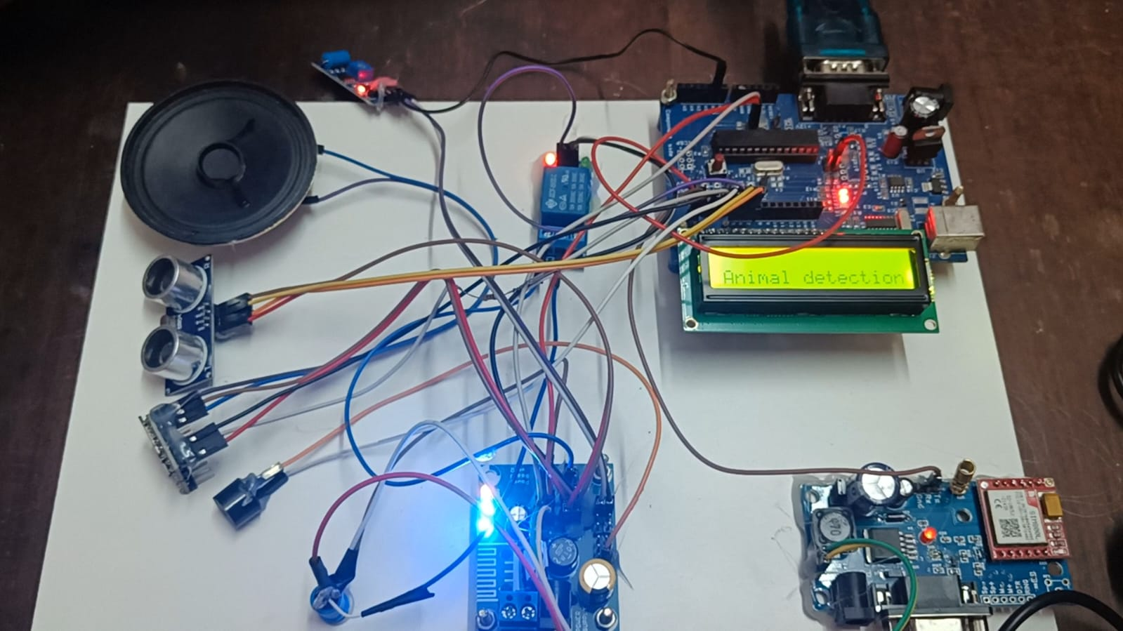

Slide 20
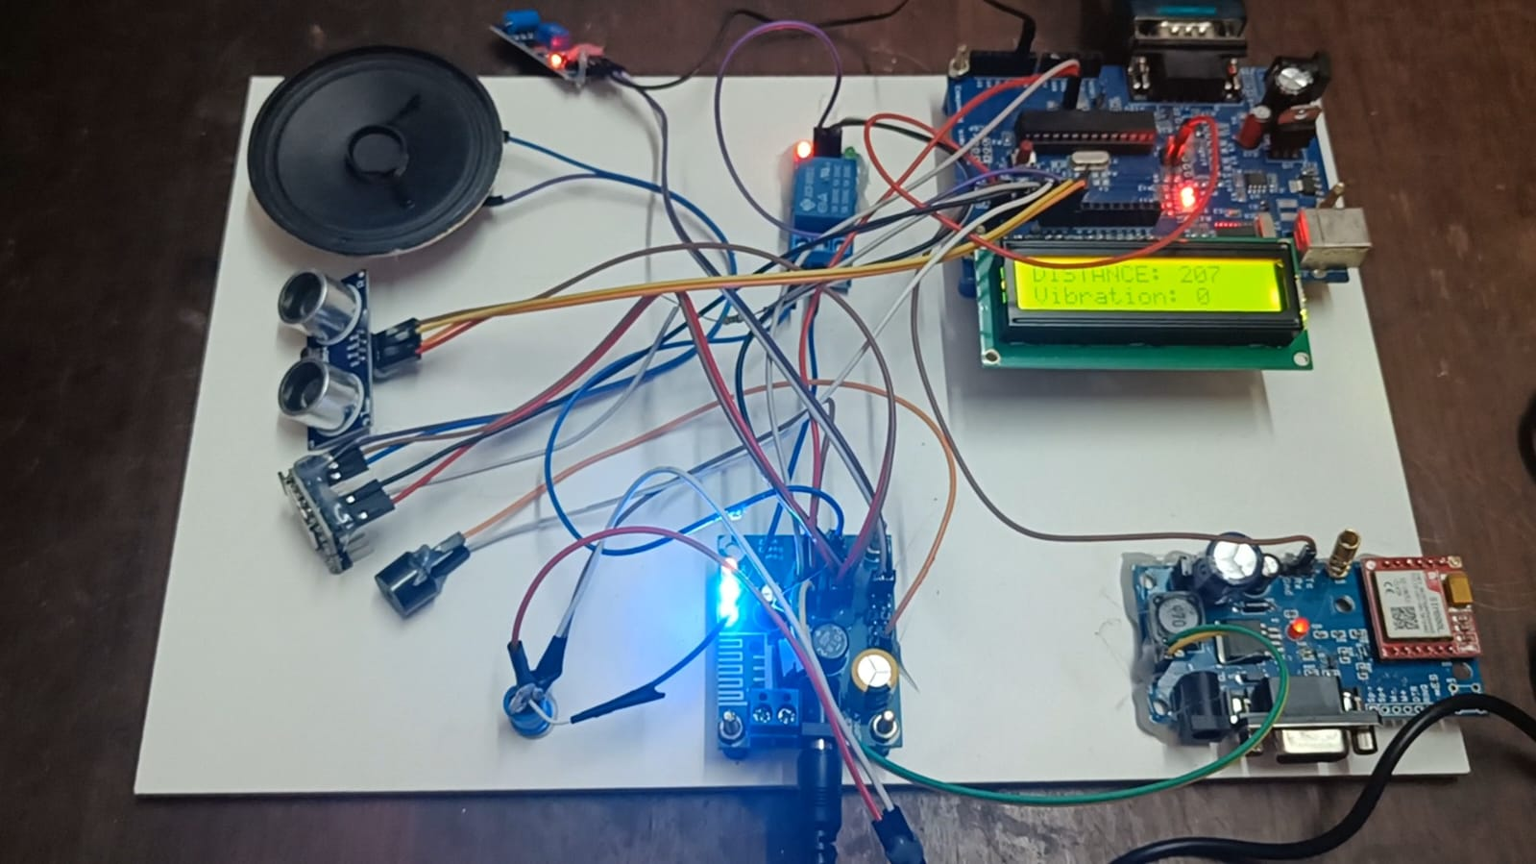

Slide 21
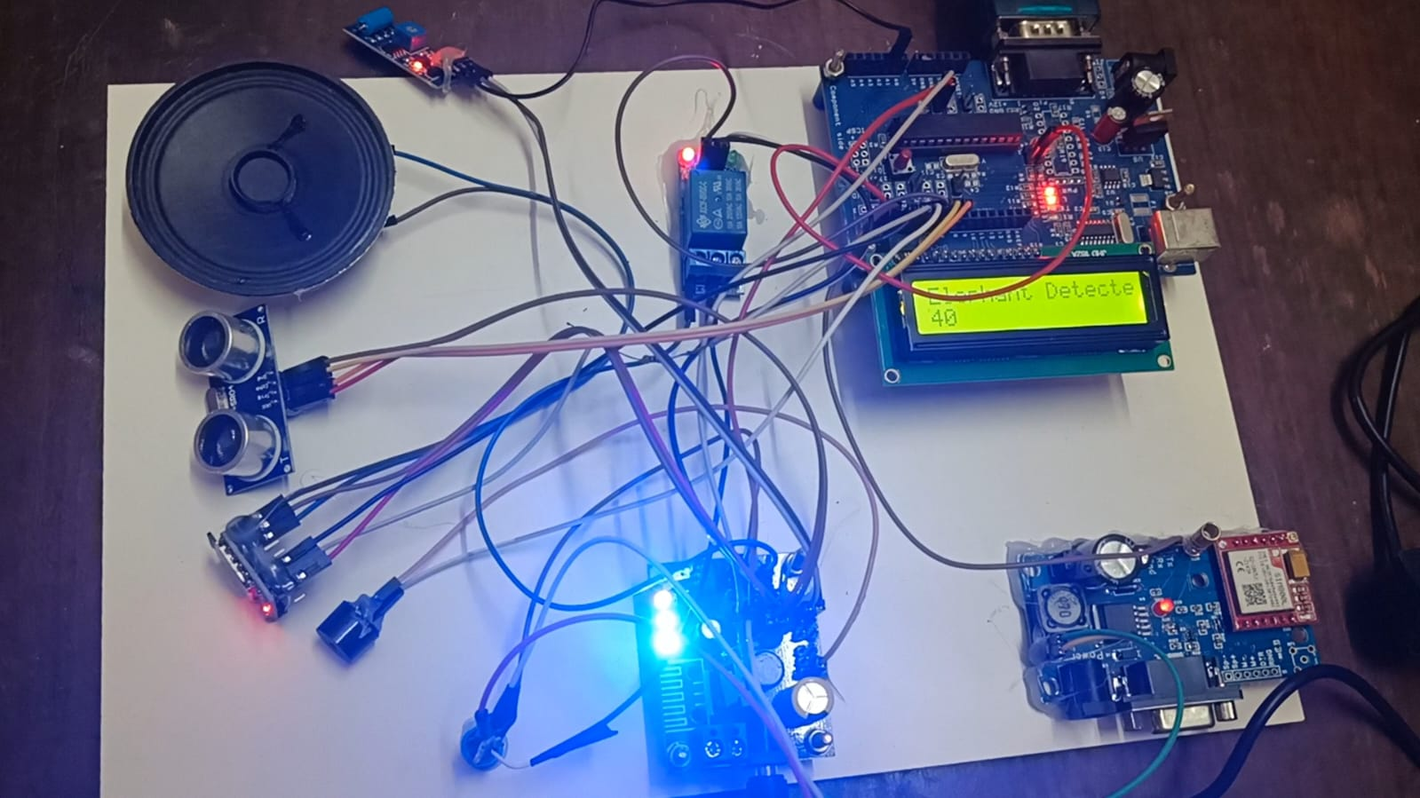

Slide 22
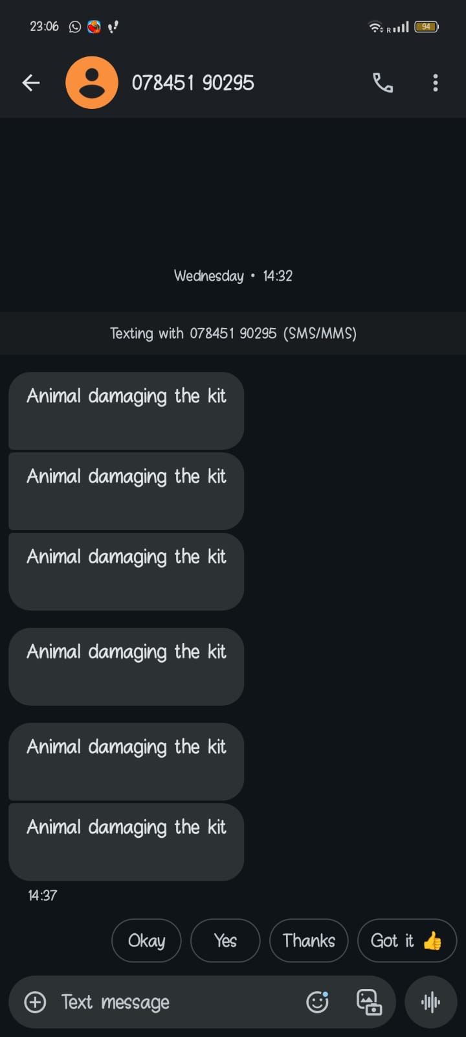

Slide 23
Result
The system effectively detects and identifies animals using ultrasonic sensors and AI.
It provides timely alerts and automated deterrence.
The system minimizes crop damage and reduces reliance on manual intervention.
It offers a balanced approach to agricultural security and wildlife conservation.
The system is cost-effective and enhances farm management efficiency.

Slide 24
Conclusion
Combines sensors, AI, and automated deterrence.
Provides timely and targeted responses.
Innovative solution for protecting agricultural lands.
Minimizes crop damage and wildlife disturbance.

Slide 25
Reference Paper
M. S. Norouzzadeh et al., “Automatically identifying, counting, and describing wild animals in camera-trap images with deep learning,” Proc. Nat. Acad. Sci. USA, vol. 115, no. 25, pp. E5716–E5725, Jun. 2018.
D. Tuia et al., “Perspectives in machine learning for wildlife conservation,” Nature Commun., vol. 13, no. 1, pp. 1–15, 2022.
E. Nepovinnykh, T. Eerola, and H. Kälviäinen, “Siamese network based pelage pattern matching for ringed seal re-identification,” in Proc. IEEE Winter Appl. Comput. Vis. Workshops (WACVW), Mar. 2020, pp. 25–34.
S. Schneider, G. W. Taylor, S. Linquist, and S. C. Kremer, “Past, present and future approaches using computer vision for animal re-identification from camera trap data,” Methods Ecol. Evol., vol. 10, no. 4, pp. 461–470, 2019.
S. Kumar and S. K. Singh, “Visual animal biometrics: Survey,” IET Biometrics,
vol. 6, no. 3, pp. 139–156, May 2017.

Slide 26
Reference Paper
E. Nepovinnykh, T. Eerola, H. Kälviäinen, and G. Radchenko,“Identification of saimaa ringed seal individuals using transfer learning,” in Proc. Int. Conf. Adv. Concepts Intell. Vis. Syst. Cham, Switzerland: Springer, 2018, pp. 211–222.
M. Vidal, N. Wolf, B. Rosenberg, B. P. Harris, and A. Mathis, “Perspectives on individual animal identification from biology and computer vision,” Integrative Comparative Biol., vol. 61, no. 3, pp. 900–916, Oct. 2021.
S. Li, J. Li, H. Tang, R. Qian, and W. Lin, “ATRW: A benchmark for amur tiger re-identification in the wild,” in Proc. 28th ACM Int. Conf. Multimedia, Oct. 2020, pp. 2590–2598.
P. Chen et al., “A study on giant panda recognition based on images of a large proportion of captive pandas,” Ecol. Evol., vol. 10, no. 7, pp. 3561–3573, Apr. 2020.
C. V. Stewart, J. R. Parham, J. Holmberg, and T. Y. Berger-Wolf, “The animal id problem: Continual curation,” 2106, arXiv:2106.10377.

Slide 27
THANK YOU

